Slide 1
Research Methodology
Kapil Deb Subedi

Slide 2

Research -Concept
Research means to search again and again to find out something new and more about a phenomenon.
;To kTtf nufpg ul/g] k6s k6ssf] vf]lhnfO{ cg'zGwfg elgG5 .
By analyzing the term 'Research', it is composed of two syllables, re and search. The prefix re means again or over again and search means to examine closely and carefully, to test and try to probe.
Re sf] cy{ k"g / Search sf] cy{ vf]lh xf] To;}n] cg"zGwfg lg/Gt/sf] vf]lh xf]
If we combine them, they form a noun describing a careful, systematic, patient study and investigation in some field of knowledge, undertaken to establish facts or principles

Slide 3
"Research is the study of an event, problem or phenomenon using systematic and objective methods, in order to understand it better and to develop principles and theories about it" (Richards et al. 1999).
Af:t"ut / a}1flgs lalwaf6 s'g} 36gf, kl/l:ylt jf ;d:odfly ul/g] uxg cWoog jf cGj]if0f nfO{ cg';Gwfg elgG5 h;sf] p2]:o goFf lzWbfGt jf 1fgsf] k|ltkfbg ug'{ xf]
Therefore the meaning of research can be explained as a careful investigation or inquiry specially through search for new facts in any branch of knowledge.

Slide 4
A}f1flgs cg'zGwfg
Research is an organized, systematic, data based, critical, scientific inquiry or investigation into a specific problem undertaken with the objective of finding answer or solution.
cg';Gwfg s'g} 36gf jf kl/l:yltdfly ul/g] ;+ul7t, Aoal:yt, tYok/s, ;ldIffTds Pa+ a}1flgs vf]h xf] h;sf] p2]Zo s'g} ;d:osf] a}1flgs ;dfwfg kTtf nufpg'xf] .

Slide 5
Main activities to be involved in research process are:
Define the Problem and find out the variables of study.
Get existing knowledge of inventory on the issue.
Design the research hypothesis or express question to present the problem.
Collect the data and convert them into information.
Analysis the information and conclude it to build-up theory or to generalize the situation
;d:o kl/eflift ug]{ / r/x? kTtf nupg]
;DalGwt laifodf pknAw 1fgsf] ca:yf s] 5 laa]rgf ug]{
cg'zGwfg kl/sNkgf jf k|Zgx? to ug]{{
tYofs+ zs+ng ug]{ / laZn]if0f ug]{
lgisif{ lgsfNg] / lzWtfGt lasf; ug]{

Slide 6
Features of Scientific Research (बैज्ञानिक अनुशन्धानका बिशेषताहरु)
1.Purposiveness
2. Rigor
3. Testability
4. Replicability
5. Precision & confidence
6. Objectivity
7. Generalizability
8.Parsimony
!_ p2]Zok"0f{
@_ lalw, lzWbfGtsf] kfngf
#_ k|of]u,kl/If0fl;Wb
$_ b'?Zttf
%_ laZjzlgotf, oyfy{tf
^_a:t'ut
&_ ;fdfGos[t
*_ ;DaGwdf ;/ntf

Slide 7
Nature /characteristics of Research
Purposiveness
Research start with a definite aim or purpose and following activities are guided by the objectives.
Rigorous
It involves good theoretical base and thought out methodology.
It enable researcher to collect the right information from an appropriate sample with the minimum degree of bias and facilitate suitable analysis of the data gathered.
pB]Zok'0f{
cg'zGwfg lglZrt pB]Zoaf6 lgb]{lzt x'G5
lalw / lzWbfGtsf] kl/kfngf
k'a{ lgwf{l/t lalw / c;n lzWbfGtx?sf] cfnf]sdf cgzGwfg u/lG5

Slide 8
3 Testability-Researcher develops certain hypothesis, then these can be tested by applying certain statistical tests to the data collected for the purpose.
4. Replicability- The research should replicate when same research conducted again for same sample with similar methodologies .

Slide 9
Precision
Precision refers to the closeness of the findings to “reality” based on a sample.
It reflects the degree of accuracy and exactitude of the results of the sample.
.

Slide 10
Confidence
Confidence refers to the probability that our estimations are correct.
That is, it is not merely enough to be precise, but it is also important that we can confidently claim that 95% of the time our results would be true and there is only a 5% chance of our being wrong.
This is also known as confidence level.

Slide 11
Objectivity
The conclusions drawn through the interpretation of the results of data analysis should be objective; that is, they should be based on the facts of the findings derived from actual data, and not on our subjective or emotional values.

Slide 12
Generalizability
It refers to the scope of applicability of the research findings in one organization setting to other settings.

Slide 13
Concept of scientific research
Science is defined as a specific method or logic of inquiry.
It has two purposes
Improve quality of life.
Develop explanatory relationship
Natural science
Study of naturally occurring objects or phenomenon like life objects, matter, earth, celestial bodies, or human body.
Social sciences
Study of people or group of people and their actions ,behaviors, preferences, views etc.
Like psychology, sociology management etc

Slide 14
Concept of scientific research
Scientific method involves determining the facts through observation and experimentation.
After classifying and analyzing the facts, scientists look for and find some causal relationships which they believe to be true.
Such generalizations called hypothesis are then tested for their accuracy.
( kerlinger,2000)

Slide 15
Steps of scientific research
Sensing or realizing the problem/ समस्या अनुभूत गर्नु New problems keep on emerge. Researchers should sense these . e.g Sales decrease in last quarter
(2) Problem identification/समस्या पहिचान गर्नु
Focus on the problems deeply
Identify the associated factors through further search of information.
Like decrease in sales might be due to poor advertisement campaign, weak logistics, low quality product ets

Slide 16
Steps of scientific research
(3) Construct the theoretical framework./ सैधान्तिक ढांचा निर्माण गर्नु
Integrate the information (variables) logically so that problem can be conceptualized. Putting all the variables in the logical framework
(4) Hypothesis formulation /परिकल्पना तर्जुमा गर्नु
Hypothesis are the logically guessed relationship between two or more variables expressed in the form of testable statements.

Slide 17
Steps of scientific research
(5) Research design / अनुसन्धान ढांचा तयार गर्नु
Research design is the strategy for conducting research. It is general framework for collecting, analyzing, evaluating data.
(6) Data collection / तथ्यांक संकलन गर्नु
Data collection is the field work process. In this step, the researcher ha to administer researcher instruments like questionnaire, interview schedule, and observation schedules etc. to collect data.

Slide 18
(7) Data Tabulation and Analysis/ तथ्यांक तालिकिकरण एबम विश्लेषण गर्नु
Collected data are edited, tabulated, coded for its accuracy and reliability. Then different statistical tools are applied to analyze the data.
The descriptive and inferential statistics are used for data analysis.
(8) Generalization / Development of theory and application./ सामान्यीकरण शिधान्त को बिकाश र प्रयोग
The final step involves interpretation and generalization of the findings into the larger bodies of knowledge about the phenomenon.
In case of applied research, specific implementation strategy is proposed to solve the problem identified by the study.

Slide 19
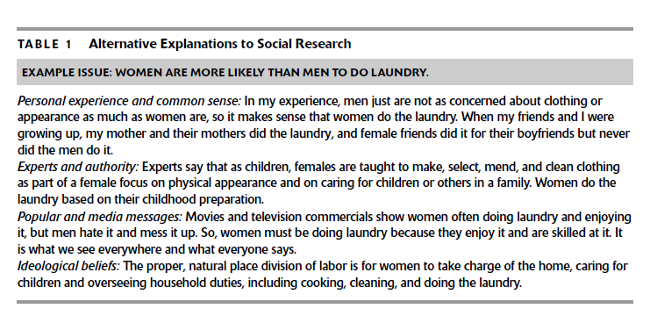

Slide 20
Types of research
Basic research ( cfwf/e't cgzGwfg_
It is undertaken to improve our understanding of some specific subject or field of knowledge. It’s prime purpose is to add more knowledge and understanding of the phenomena that is generalizable. ( building theories & testing theories)
2. Applied research ( Aoaxfl/s cg'zGwfg_
it is conducted to solve a specific problem of practical nature. Theoretical solutions of a problem may not work most of the times. Therefore managers conduct applied research to generate more information on their specific problem and take decisions to solve those.( solving specific problems)

Slide 21
Approaches to research
Quantitative research- (kl/df0ffTds cg'zGwfg_
It seeks the facts and causes of phenomena with little concern for the subjective state of variables.
such methods depend on quantitative data which are in number form.
It believes on analysis of data using statistical approaches and their factual findings.
Counting or measuring events or phenomena

Slide 22
Approaches to research
Qualitative approach-
It is method basically used in social sciences with subjective interpretation of events and phenomenon.
It emphasizes qualitative data instead of numerical facts and figures.
Individuals perceptions and experiences on some events and phenomena are the sources of data.
Case studies, exploratory research are the example

Slide 23
New branches of qualitative research;
Ethnography- descriptive account of social life and culture
Phenomenology-study of human experience in everyday life
Hermeneutics- study of theory and practice of interpretations of literary and religious text.
Constructivism-reality and knowledge are socially constructed. Observable facts are not objective facts.
Subjectivism- knowledge generated from the mind, without reference to reality.

Slide 25
Paradigm shifts in research
Paradigm is set of assumptions about how research ought to be conducted to find out the truth. There is no ‘best type’ or ‘best way’ of conducting research.
1. Positivism –it was a dominant philosophy of research throughout 19th to 20th century, and was based on the works of French philosopher August Comte ( 1798-1857).
It believes the science and knowledge creation should be based on what can be observed and perfectly measured.
Positivism rely exclusively on theories that can be directly tested through empirical data and their quantitative analysis.
Subjective understanding may be of great importance in our lives but they deviate from scientifically established facts.
Assumptions
World is fixed entity. Hence, there is a single world reality
Social reality can be studied by using scientific methods to facilitate verification.
Research methods of natural science can applied to social sciences too

Slide 26
Paradigm to research
2. Interpretivism
It explores the cultural and historical interpretations of the social world.
It believes on qualitative insights into social phenomena.
Social reality is viewed by different people in different ways.
People perceive and interpret the world and events in their own way.
Many things in the social world cannot be perfectly measured and quantified.
As people interpret the events and phenomena in their own way, there are multiple social realities.
These realities change across time and place.

Slide 27
Paradigm to research
3. Triangulation
It is mixed method approach.
This methodology contains the quantitative and qualitative approaches of conducting research.
By using the best practices of both approaches, researchers can build on the strength of each type of data collection and minimize the weaknesses of any single approach.
It can increase both the validity and the reliability of the research results.

Slide 28
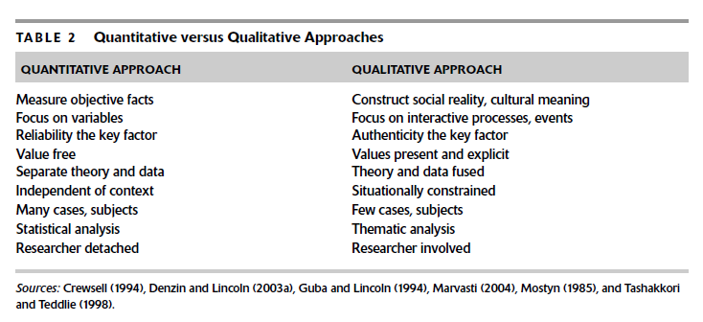
Quantitative Vs Qualitative Approaches

Slide 29
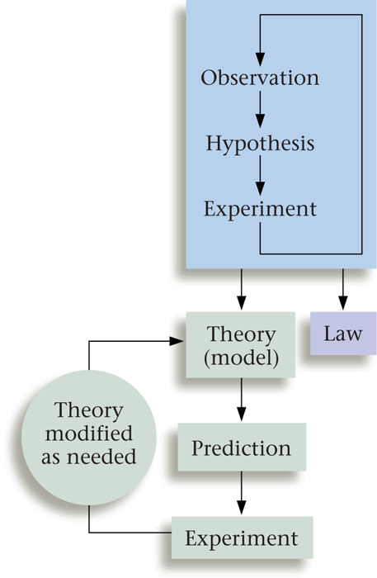
C. The Scientific Method

Slide 30
Difficulty of applying scientific methods in social research
Complexity of subject matter
Social science deals with human beings and their differing activities, attitudes, motives, beliefs and values.
Theses all are uncontrollable variables which are extremely complex and diverse subject.
laifoa:t"sf] hl6ntf
;fdflhs cg';Gwfgsf] laifo dfga Aoaxf/, dgf]la1fg, dfglao ;DaGw / d"Nok|0ffln cflb x"g h'g laifosf] AofVof cfkm}df hl6n 5 .
lo laifonfO{ lgolGqt u/]/ kl/If0f ug{ hl6n 5 .
Notes:
Social science deals with human beings. Human differs from each other in their activities, attitudes, motives beliefs and values.
Theses all are uncontrollable variables which are extremely complex and diverse subject.

Slide 31
Difficulty of applying scientific methods in social research
Difficulty in accurate measurement
In pure science, accurate measurement of variables is possible but in social science due to complex and diverse nature of variable, the accurate is not possible.
Honesty and attitude of respondent is difficult to ascertain
oyfy{ dfkgdf sl7gfO{
;fdflhs la1fgdf r/x? hl6n / lalawtfk"0f{ x'g] x'bf o:sf] oyfy{ dfkgdf ;d:o 5 .
pTt/bftfsf] OdfGbfl/tf / Aoaxf/ gfKg sl7g 5 .

Slide 32
Influence of the measurement process on results
The respondents when they know that they are being observed and measured often tend to react other than normally.
Howthorne effect- effect of lighting on employee output
Difficulty of using experiment to test hypothesis
In pure science it is possible to establish meaningful laboratory condition in which the researchers may control all the variables, allow one to fluctuate and then measure the results.
However, a wider society is not a laboratory. Replication can not be carried out in social science
Dffkg ks[osf] kl/0ffddf c;/
pTt/bftf hf] dfly kl/If0f ul/G5 olb p;n] Tof] yfxf kfPdf km/s Aoaxf/ ug{ yfN5 .
Howthorne effect- effect of lighting on employee output
k|of]u / kl/If0fdf sl7gfO
Eff}lts la1fgdf Nofa kl/If0f u/]/ r/x?sf] ;DaGw kTtf nufpg ;lsG5 t/ ;fdflhs la1fgdf lgolGqt Nofa agfpg ;lsb}g.

Slide 33
Difficulty of making accurate prediction
In lab the scientist can predict the behavior of a chemical with a great deal of precision, predicting the behavior of voters in election is not nearly so exact . Because, they do different things in different situation.
Consequently accurate prediction is more difficult in economics, business, politics, management than in physics and chemistry.
k"af{g'dfg ug{ sl7g
a}1flgsx?n] Nofaleq /;fogx?sf] Aoaxf/ k"af{g'dfg ug{ ;s] h:t} ;fdflhs la1fgdf dfG5]sf] Aoaxf/ k"af{g'dfg ug{ ;lsb}g . lsgls of] kl/l:ylthGo x'G5 .

Slide 34
Problematic objectives of the investigator
Scientific research demands impartiality and objectivity in reporting of data.
Investigators become partial in collecting data
Bias may be unconscious.
During interviewing process, the researchers may cause bias through the wording of questions or the use of leading questions.
cg'zGwfgstf{df x'g] ;d:o
cg';Gwfgsf] z'Wbtf tYofs+df lge{/ u5{ .
cg';Gwfgstf{ tYof+s ;s+ngdf kIfkftL x'g ;S5 .
tYof+s ;s+ngdf hfg]/ jf ghfg]/ x'g ;Sg] kIfkftsf] sf/0f cg';Gwfgsf] z'Wbtfdf ulDe/ c;/ k5{ .

Slide 35
Applied Vs Basic Research
Fundamental Research
Increase the knowledge of business and its management.
Relates with universal problem.
Valuable to the society in general
Choice of topic by the researcher.
No limit of time generally.
Explains basic Social issues.
It covers more population / Sample.

Slide 36
Basic Vs Applied Research
Applied Research
Help to understand about the particular business problem.
Finds the solution of particular problem.
New knowledge limited to a problem.
Researcher is given the topic.
Tight time scale.
Practical problem solving.
It relates with specific sample/units /case.

Slide 37
Paradigm of research
Quantitative Vs Qualitative research
Under quantitative research, data are measured in terms of quantity or number by using some measurement scale like meter, liter, pound, kg, currency, etc.
Data are collected by secondary sources or questionnaire methods.
Data are analyzed by using statistics like mean, median, SD, regression etc and some conclusion are derived and generalized.
;Vo+fTds / u'0ffTds cg';Gwfg
;Vo+fdf AoSt ug{ ;lsg] tYo+fsx? ;s+ng u/L laleGg tYof+szfl:qo lalwx?sf] k|of]u af6 ul/g] laZn]if0f dfkm{t glthfdf k'Ug] k|s[onfO{ ;V+ofTds cg'zGwfg elgG5 .
n]vf, laTTf zf:q h:tf laifodf ul/g] cg'zGwfgdf of] lalwsf] k|of]u x'G5 .

Slide 38
Some subjects are related with human behavior, perception, attitude and psychology, which can not be expressed in number or quantity. They are subjective by nature and related with human values, culture, experience, beliefs etc. so the research conducted in such subjects are qualitative research.
Qualitative research are conducted in some small sample, unit and cases and they seek to develop deep understanding and interpretation of the subject matter by counting, categorizing, pattern study etc but it uses less statistics.
Dffga dgf]la1fg, d'No k|0ffnL, ;fdflhs ;DaGw / ;:s[lt h:tf lgtfGt laifout cawf/0ff ;+u hf]l8P/ ul/g] cg'zGwfgnfO{ u'0ffTds cg';Gwfg elgG5 .
o:tf] cg'zGwfgdf k|of]u ul/g] tYo+fsx?nfO{ ;V+ofdf AoSt ug{ ;lsb}g . tYo+fsx? cGt/aftf{, 36gf canf]sg, b}lgsL cWoog, k|f]kmfOn laZn]if0f cflbsf[ dfWodaf6 ;s+ng ul/G5 / tYo+flso lalwx?sf] Go'gtd k|of]u u/L laZn]if0f ul/G5 / lgisif{ lgsflnG5.
HRM, OB, Marketing h:tf laifodf ul/g] cg'zGwfg u'0ffTds k|s[ltsf] x'G5 .

Slide 39
Nature of management Research
Exploration:
Exploring the reality is to identity the problem and the variables causing it or related with it.
Exploration of the problem is accomplished through familiarization with the available literature, interviews with experts, focus groups, or some combinations.
Exploration adds some preliminary knowledge and facts about the phenomena.
Exploration is like the journey of an unidentified destination but aims to define it.

Slide 40
Description:
Description adds more to our existing knowledge explaining the nature of variables involved, their inter relationship and the multiple effects of the factors impinging on a situation.
To discover answers to the questions who, what, when, where and some times how is the description.

Slide 41
Explanation :
An explanation goes beyond description and attempts to explain the reasons for the phenomenon (that the description only observes the phenomena).
In an explanatory purpose, the researchers uses theories or at least hypothesis to account for the forces that caused a certain phenomena to occur.

Slide 42
Prediction :
If we can provide a plausible explanation for an event after it has occurred; it is desirable to be able to predict when and in what situation the event will occur.
The possible relationship between the factors and the particular event, help the researchers to frame a verifiable generalization that explain how the variables involved behave in certain situation.

Slide 43
Research in business: Concept
During last decade, dramatic changes have been occurred in business environment.
Emerging from historical economic role, the business organization has evolved in response to the social and political mandates of national policy, technological growth, and continuing innovation in IT.
These changes have created new knowledge needs for the manager for considering any decisions.

Slide 44
Research in business: Concept
The trend toward complexity has increased the risk associated with business decisions, making it more important to have a sound information base.
The complex business decision-making environment demands that managers have more and better information on which to base decisions.
Business research is a systematic inquiry whose objective is to provide information to solve managerial problems.

Slide 45
Research in Business: Concept
Business research
Complex business environment
Changing organizational problem
Management dilemma

Slide 46
Nature / type of management research
Policy Research: Research designed to analyze situations at the strategic level and to formulate overall policy proposals.
Managerial Research: is related to the specific problem of limited scope for which management has need of additional information for decision-making. (Feasibility study of new product)
Action Research: Continuous collection and analysis of data during the normal on going operation of the business so as to make routine / normal business decisions.
Evaluation Research: It is the research oriented toward formal and objective measurement of the extent which a given action, activity or programme has achieved its original objective.

Slide 47
Management research methods
Meaning | Data requirements and analysis | Research objectives
Policy research -To formulate major policy proposal -To establish their priorities -To identify their implications | -Macro level data about environmental forces, -Organizational situations and competitive factors -Longitudinal data (bL3{sflng_ -Time series data | -Identifications of policy options -Identifications of policy priorities for the organizations
Managerial research -To study the ongoing operations or projects -To help in improving managerial effectiveness -To help in decision making | -Specific and detailed data about the operations or projects -Data collections through MIS -Collections of qualitative data -Exploring the situations for in depth understanding Survey research methods Observational methods Experimental methods | -Identification of the problem situation -Identification of decision options -Precise recommendations for actions to be taken
Action research -To feed the information into the organization -To improve functioning -To improve managerial action -To suggest future courses of actions | Continuous gathering and analysis of data -Problem specific data -Opinion surveys -Observations -Satisfaction level -Morale surveys -Frustration index | To recommend the action to be taken with regard to -Organizational structure -Rules -Reward and punishment system -Performance evaluation -Work environment
Evaluation Research -To measure achievements against the objectives -To identify gaps and problem areas -To suggest the improvements required | -Micro level data -Program review and evaluation data -Comparative performance -Internal surveys | -Identification of programme strength and weaknesses -Recommendation for programme improvements

Slide 48
The Value of Business Research for Managers –
Research can be employed in each of the following four stages of management decision
Identification of problems and/or opportunities
Useful for strategic planning, analysis of internal and external organizational environment.
(2) Diagnosing and Assessment of problems/ or opportunities
Its purpose is to gain insight into the underlying reasons and causes for the situation. If there is a problem, it asks what happened and why? If there is an opportunity, it seeks to explore, clarify and refine the nature of the opportunity and, in the case of multiple opportunities, seeks to set priorities

Slide 49
The Value of Business Research for Managers – (2)
(3) Selection and Implementation of Courses of Action
After alternative courses of action have been determined, selection of the best possible course.
(4) Evaluating the Course of Action
Research are used after a course of action has been implemented in order to determine whether activities have been properly implemented and have accomplished what they intended to do

Slide 50
When Should Business Research be Undertaken?
Is sufficient time
available?
NO
Yes
Is information
inadequate?
Do not
undertake Business Research
Yes
High importance
of decision?
Yes
Research benefits
greater than costs?
Undertake Business Research

Slide 51
Value and Costs of Undertaking Business Research
VALUE
COSTS
Decreased Uncertainty
Higher Likelihood of Correct Decisions
Better Business performance
Higher Profits
Better Reputation
Research Costs
Delay in Making Business Decisions
Disclosure of Information to Rivals
Possibility of Error

Slide 52
Why managers should Know research
Managers have to make decision to prepare the organizational activities.
They have to decide different plan, policies and programs continuously to achieve desired goals.
The success of an organization depends on quality of decision taken by manager. Appropriate decisions have to be taken in right time for success.
Decision cannot be taken in vacuum. They must be based and backed by informations. A manager should have right and adequate information in different stapes of management process.

Slide 53
Why managers should Know research
Information should be collected and processed before their utilization. The information system must be established in an organization to acquire the information in time. The sub-system of an information system are:
Internal Information sub-system
External Information sub-system
Research information sub-system which studies to a problem to find out the effective solution. Managers have to focus attention on it to fulfill the needs of information to take an appropriate decision.
Research is necessary in every management functions and process. Hence a manager should have knowledge and skill of research methodology to solve their business problems.

Slide 54
Ethical issues in research
Put pressure on the participants to grant access to information
Violate an individual’s right to privacy
Force respondents to provide personal and confidential data.
Possible deception of participants
Fabricate the entire set of data.
Select only the best data for reporting
Claim credit for the work done by others
False reporting of data or event.
Not maintaining confidentiality and anonymity.
Report data without permission from the organization.
Publish the same paper in two different journals without telling the editors

Slide 55
For ethical research
Honesty -Honest reporting data, results, methods and procedures, and publication status.
Objectivity- unbiased and impartial explanation of research design, data interpretation, peer review and so on.
Integrity-act with sincerity and strive for consistency of thought and action.
Carefulness-keep good records of research activities and avoid careless errors and negligence.
Legality-know and obey relevant laws and institutional and governmental policies.

Slide 56
For ethical research
Non-discrimination-avoid discrimination against anybody on the basis of sex, race, ethnicity, language or other factors.
Confidentiality- protect confidential communications, such as personal records, correspondence, trade secrets, and patient records.
Respect for intellectual property-honour patents, copyrights, and other forms of intellectual property. do not use data or other documents without permission. Give credit where credit is due

Slide 57
Common misconceptions of research
Research has to involve a dramatic discovery or breakthrough in scientific knowledge.
Research can be carried out by a few highly qualified experts.
Research is the panacea for all ills
Research has to be empirical or mathematical.
Research approaches and techniques are same for all sciences
Research must be focused on knowledge generations.
Research is fact finding and fact transcribing

